Slide 1
Diabetes Prediction Using Machine Learning
A Data-Driven Approach for Proactive Healthcare
Presented by: Olatunde Emmanuel
Client: Stark Health Clinic
Date: 19th June 2025

Slide 2

Project Background (Situation)
Problem Context:
Diabetes presents serious health risks and cost implications.
Stark Health lacks precision in early diabetes detection.
Project Goal:
Use patient data and machine learning to predict diabetes onset.

Slide 3
Data Overview (Task)
Dataset Info:
Rows: 100,000 | Columns: 9
Target Variable: diabetes
Features:
Demographic: Gender, Age
Medical History: Hypertension, Heart Disease, Smoking
Biometrics: BMI, HbA1c, Blood Glucose
1
3
Initial Issues Identified:
Class imbalance (8.8% diabetic)
Duplicates (3,854 removed)
Categorical noise in gender, smoking_history
2

Slide 4
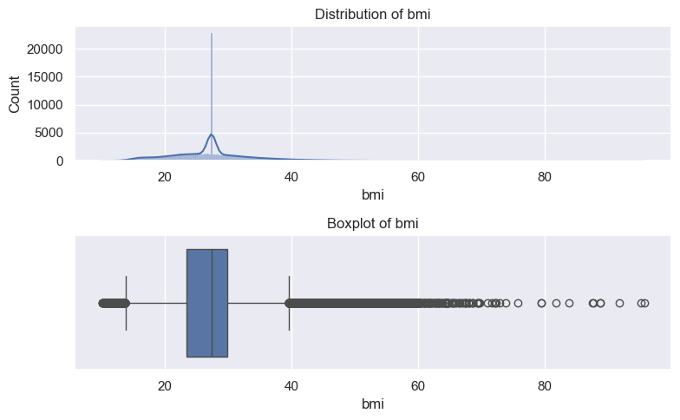
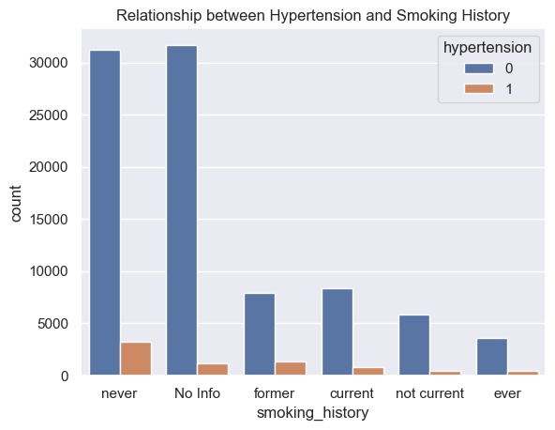
EDA Insights (Action)
Univariate Analysis Highlights:
Most patients: Female, non-smokers, non-hypertensive
Age and BMI distributions are right-skewed
Outliers observed in BMI and glucose levels
Bivariate Insights:
Diabetes more common among:
Hypertensive & heart disease patients
Current/former smokers
Patients with high HbA1c & blood glucose

Slide 5
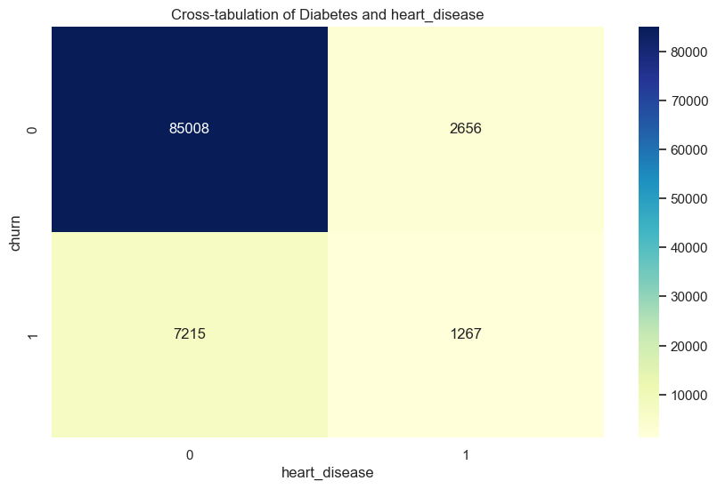
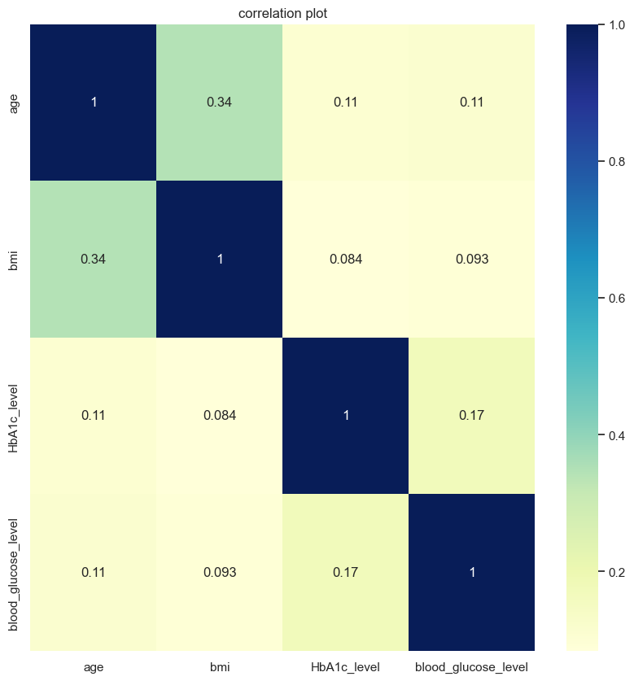
Feature Engineering & Modeling (Action)
Engineering Steps:
Chi-square & correlation tests
Label encoding, standard scaling
Applied class weighting to handle imbalance
Models Trained (Baseline + Tuned):
Logistic Regression
Decision Tree
Random Forest ✅
KNN
Tuning Method: RandomizedSearchCV (cross-validated)

Slide 6
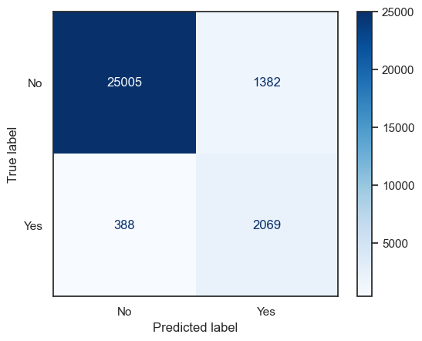
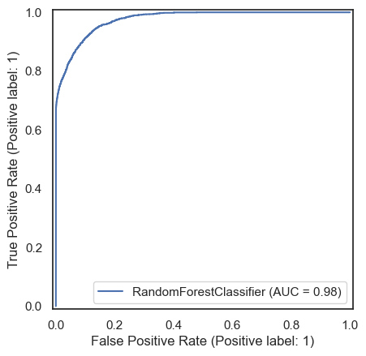
Model Evaluation (Result)
Model | Accuracy | ROC-AUC | Recall (Diabetes) | FN
Logistic Reg. | 88.5% | 0.96 | 88% | 286
Decision Tree | 95.1% | 0.853 | 73% | 655
Random Forest 🏆 | 93.9% | 0.975 | 84% | 388
KNN | 96.1% | 0.931 | 61% | 963
Best Model: Random Forest — strong AUC and recall, well-suited for healthcare prediction tasks.

Slide 7
Business Impact & Metric Focus
Why Recall Matters:
In healthcare, false negatives are critical.
Missing a diabetic patient can delay treatment and worsen outcomes.
Business Value: ✅ Proactive patient care ✅ Better resource planning ✅ Reduced long-term costs

Slide 8
Thank you.

